Slide 1

Flight Delay Analysis
Data Analysis Project – Group 1
Ms. DIPIKA PANDEY
Mr. Ananta Dnyaneshwar Patil
Ms. sapana mahesh patil
Mr. Kavesh Harish Visaria
Ms. Noopur Jaiswal
Ms. Swarnika Jaiswal

Slide 2
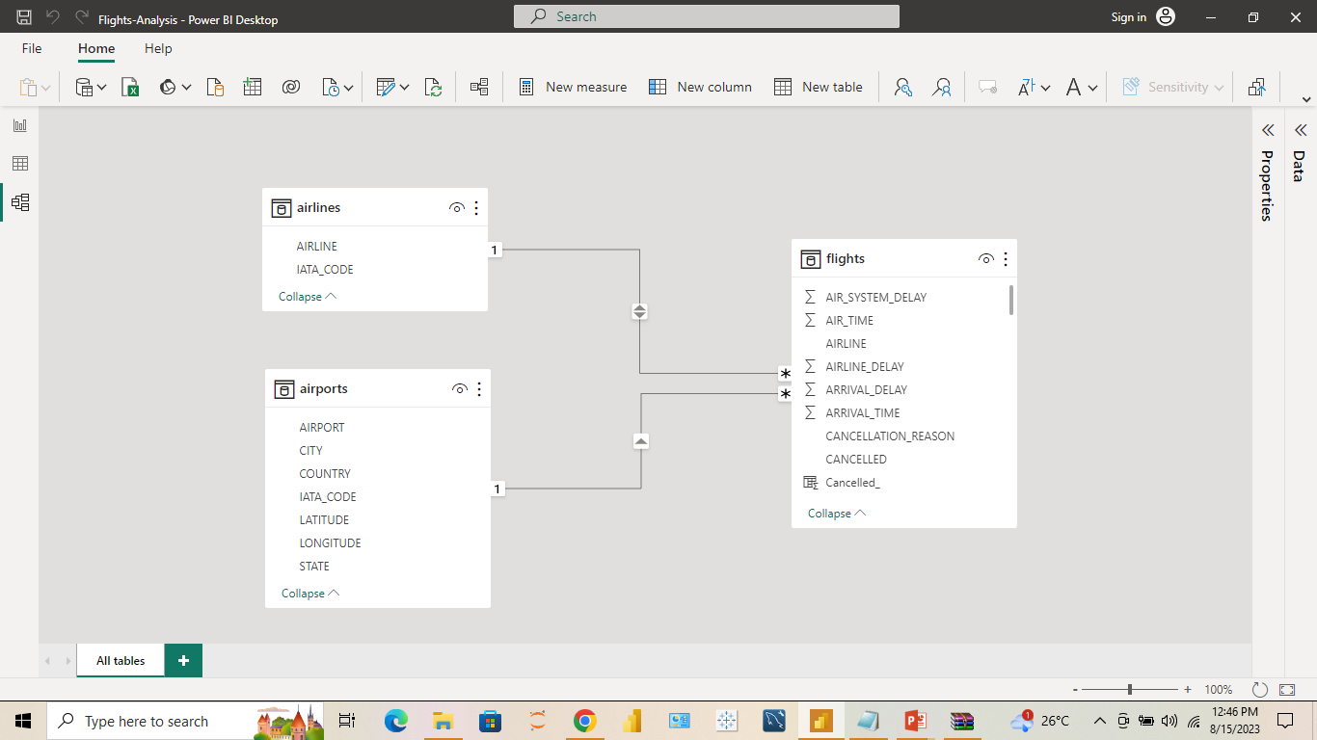
Flight Delay Data
Data Analysis Project – Group 1
Ms. DIPIKA PANDEY
Mr. Ananta Dnyaneshwar Patil
Ms. sapana mahesh patil
Mr. Kavesh Harish Visaria
Ms. Noopur Jaiswal
Ms. Swarnika Jaiswal
Mr. Sampath Potnuru

Slide 3

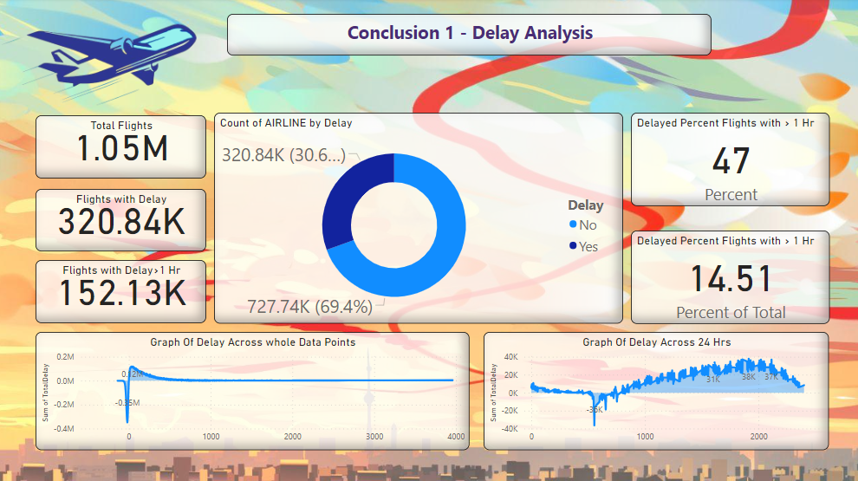
Overview - Delay Analysis
Total Flights in the DATA for Analysis are around 1M and Total 320K Flights have Delay of More than 10 Min. Means around 30% of Flights gets delayed.
Around 152K Flights have Delay of more than 1 Hr. Which Means that 47% of the all the Delayed Flights have Delay more than 1 Hour…… However only 14.5% of all the Flights have Delay of more than 1 Hr
Most of the Data Points are between Delay between -17 Min and 60 Min but many points are also between 60 and 500 Min
Checking the Delay Vs Time of Day, we come to know that Most Flights That Delay are between 12 PM to 9PM

Slide 4
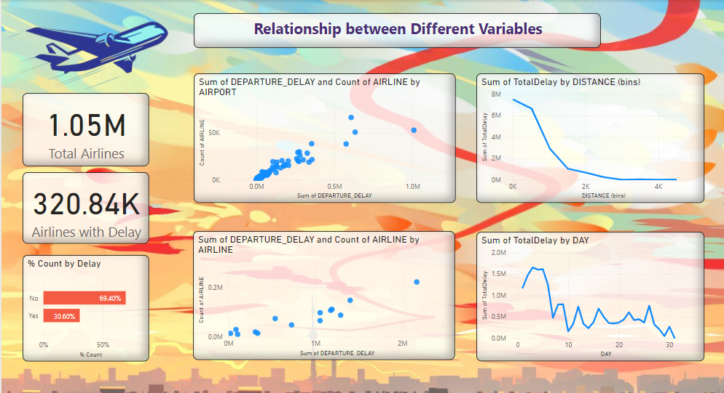
Overview - Delay Analysis
We see that More the Airport has number of Flights, More the Delay on that Particular Airport. There is a Linear Relationship these 2 Variables.
We see that MORE the Airline has no of Flights, More the SUM of Delay for that Airline. There is a Linear Relationship these 2 Variables.
WE we PLOT DELAY and DISTANCE that we come to know that flights with 0-500KM have MAX Delays while the flights with 500KM – 1000KM have little less delay… while flights with 1000KM or more has lesser delay
IF we plot Delay with Daywise data then we can say that WEEK1 of any Month has moST delay compared to other Days in Month

Slide 5
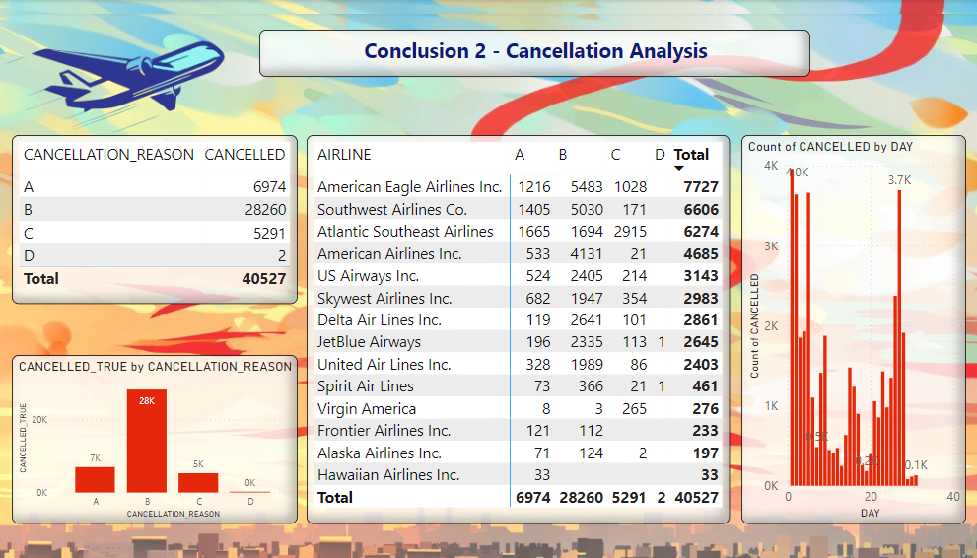
Overview - Delay Analysis
IF we PLOT the Cancellation, with cancellation reason then We can see that most flights have been cancelled, because of reason B, followed by A and C.
We can also see flights wise data for cancellation, American Eagle, Southwest and Atlantic Airlines have most FliGHTS cancellation as compared to Others
We we plot Cancelation with day of the Month then we can see that most flights get cancelled either at between 1 to 10 or between 20 to 28 Date of the Month

Slide 6
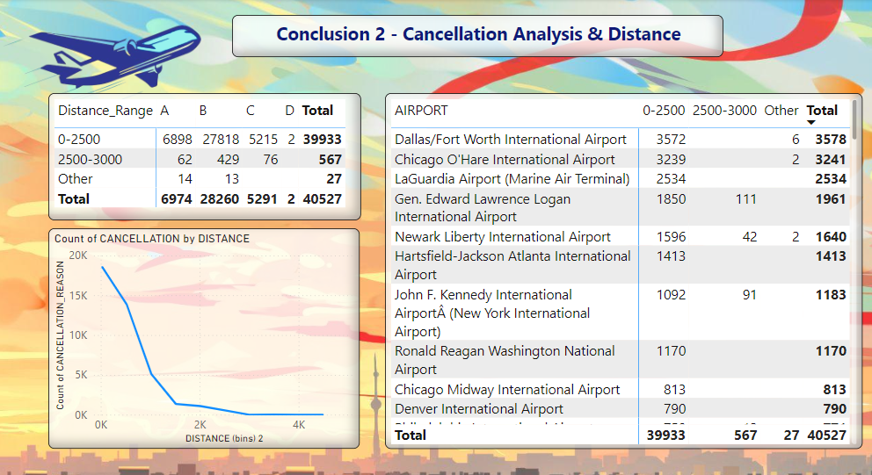
Overview - Delay Analysis
Plotting Cancellation with Distance we come to conclusion that most of the cancellations are for Distance between 1-2500. In that too Max Cancellations are for Flights of Less than 1000 KM distance.
We can also see flights wise data for cancellation. American Eagle, Southwest and Atlantic Airlines have most Flights cancellation as compared to Others
We can also see the Airport wise Cancellation Details along with Distance with Max Cancellations

Slide 7
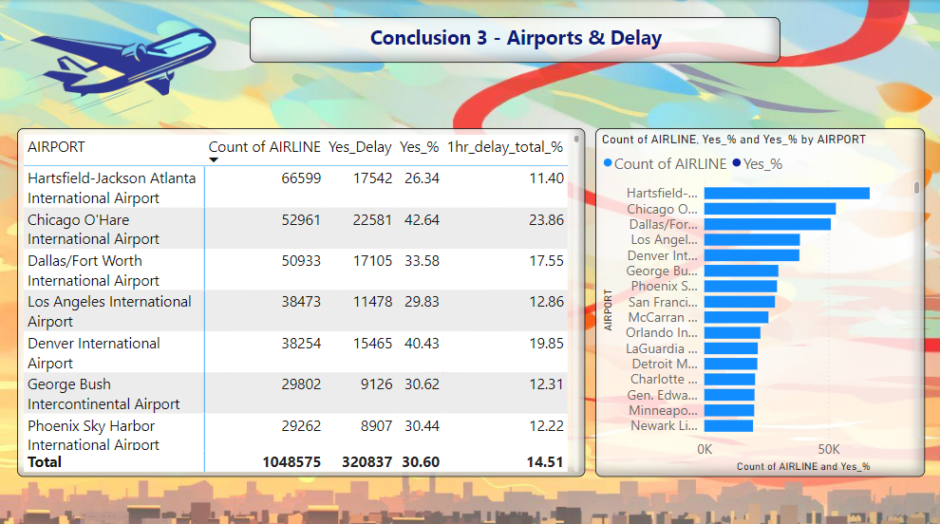
Overview - Delay Analysis
Plotting DELAY with DIFFERENT Airports, we come to conclusion, that some of the airports have delays as high as 50%.
IF we check the top 3 busiest airports we see that the delays are 26%, 42% and 33% at these airports
However if we check the % of flights that have delay of more than 1 hrs, then its 11%, 23% and 17% for the top 3 Busiest Airports

Slide 8
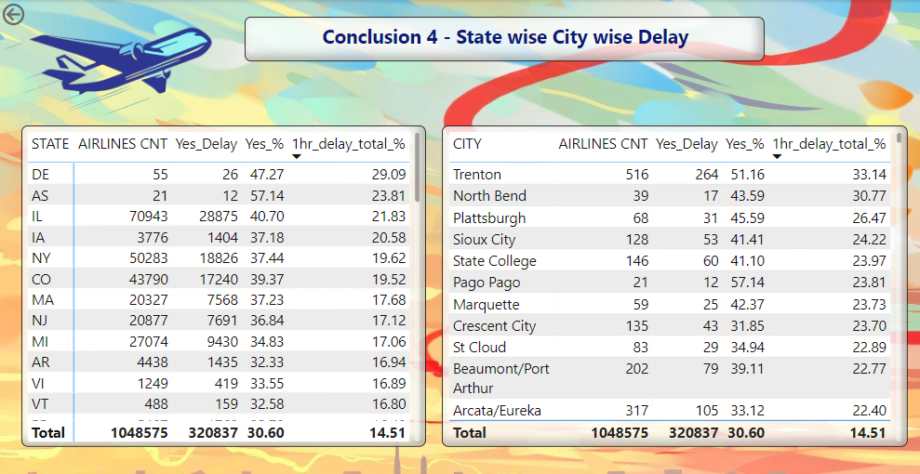
Overview - Delay Analysis
Plotting DELAY with DIFFERENT States and Cities, we come to conclusion that the delay is not equally distributed across all states and cities.
In SOME cities, the rate of delay is much higher. For Example 51% of all the flights in Trenton gets delayed, while 33% of flights have delay of more than 1 Hour. Similarly we see that that in IL state, 40% of flights gets delayed, in which 22% of flights have delay of more than 1 Hour.

Slide 9
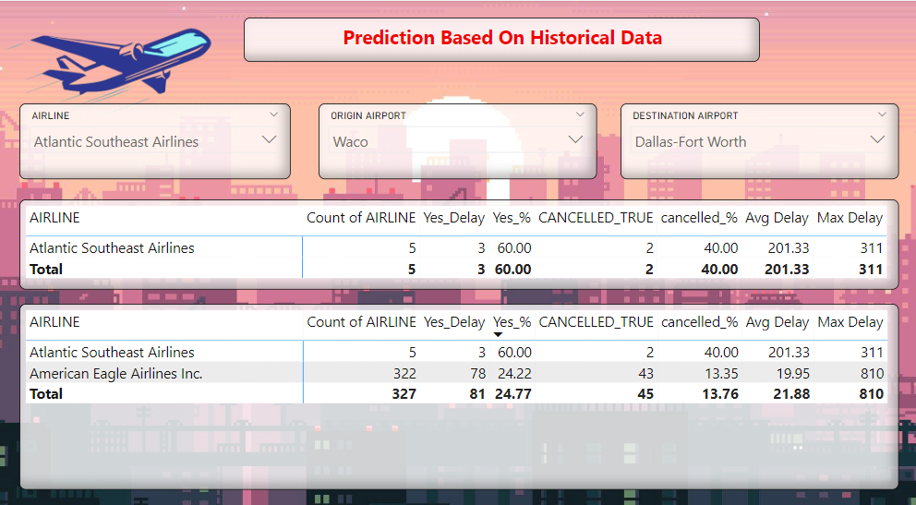
Overview - Delay Analysis
We have made a Dashboard that gives the overall View of the expected Delay based on historical data
We have to enter airline detail, origin and destination airport.
In this example we see that if someone will fly through atlantic southeast airlines between these cities, then there is 40% chance that the flight will get cancelled and 60% chance that the flight will get delayed
In the second table it also gives some other airline details with there expected results

Slide 10
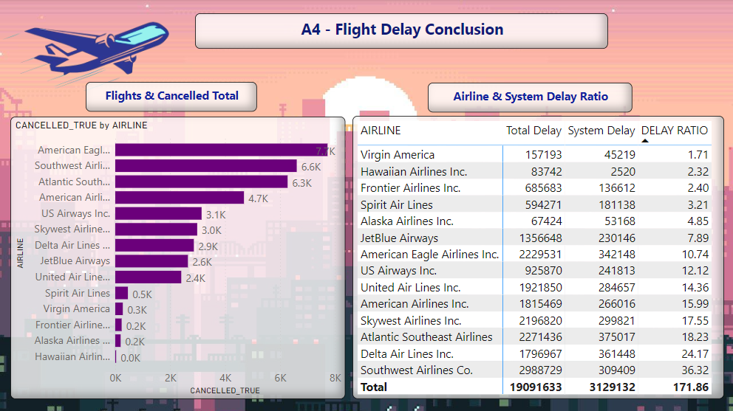
Overview - Delay Analysis
We have Calculated a Delay Ratio based on how much of delay is System delay out of the Total Delay.
So HERE for airlines which have less delay ratio need to work on there system delay. System delay could be the internal delay caused by plane engine or some other internal reason.
Flights which has more oF delay ratio need to work on there time Management, to make sure that the flight departure is on time and other things, to reduce there delays.

Slide 11
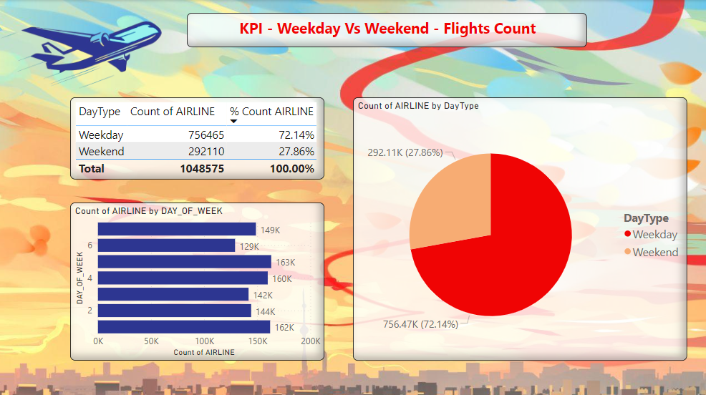

Slide 12
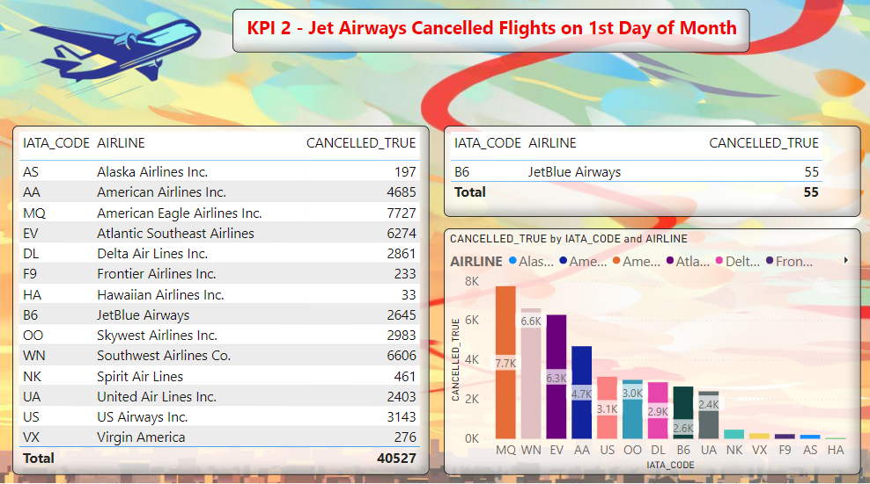

Slide 13
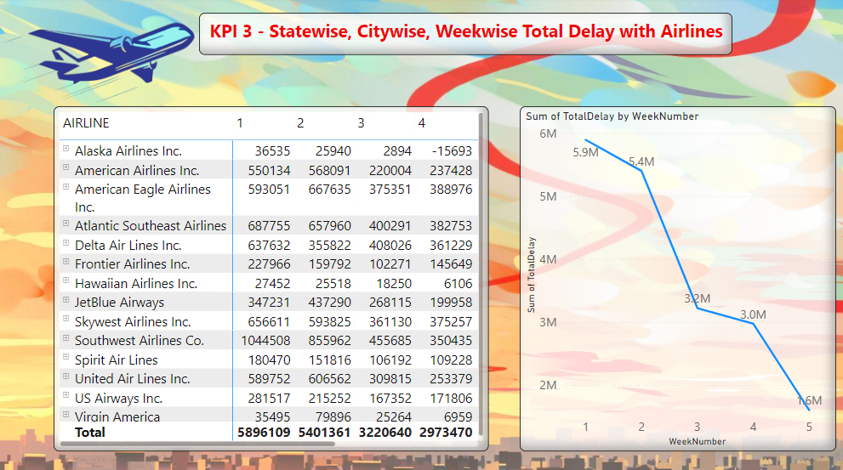

Slide 14
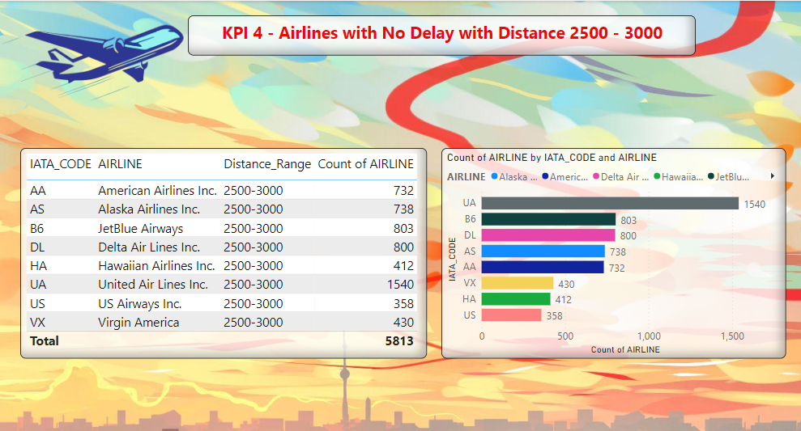

Slide 15
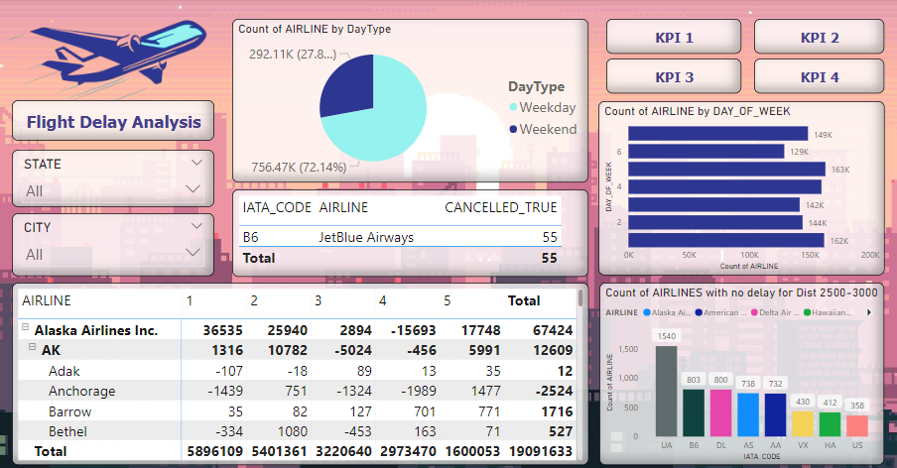

Slide 16
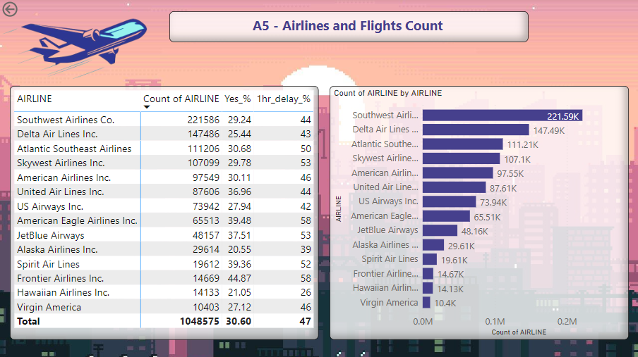

Slide 17
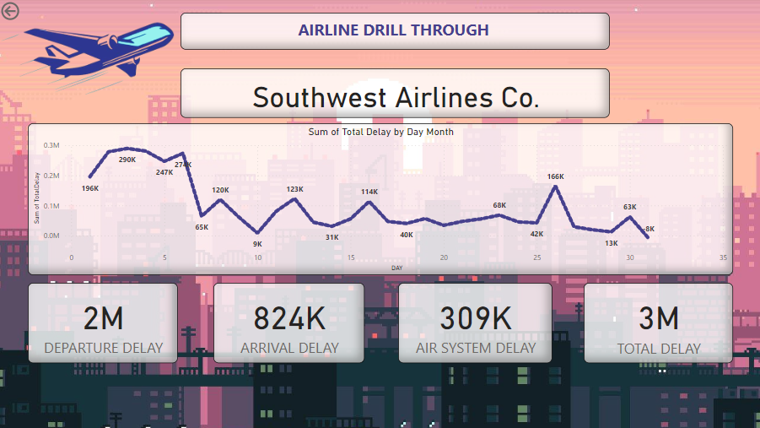

Slide 18
Conclusions
Overall 30% of the Flights get Delayed. From that 30% around 47% of the Flights have Delay of more than 1 Hour
All the Flights that travel the distance LESS than 1000KM need to work on there their delay and cancellation Rate.
Airport, State and City also play and important role on delay of flights. So those Airports need to improve there Timings and Air traffic Control Systems to reduce the delays
Airline Companies need to either work on Either reducing there system Timings or need to work on there time management or departure delays to make sure that the delays are as less as possible

